Slide 1
Results PET MR Age

Slide 2
CN

Slide 3
Correlations
SUMMARYSUVR_WHOLECEREBNORM
FDG-PET BAG
n r CI95% p-val
spearman 148 0.010911 [-0.15, 0.17] 0.896732
MRI BAG:
n r CI95% p-val
spearman 148 -0.00295 [-0.17, 0.16] 0.972006
ABETA42_recalculated
FDG-PET BAG
n r CI95% p-val
spearman 133 -0.10999 [-0.28, 0.06] 0.214659
MRI BAG:
n r CI95% p-val
spearman 133 0.003742 [-0.17, 0.18] 0.966431
TAU
FDG-PET BAG
n r CI95% p-val
spearman 133 0.030792 [-0.14, 0.2] 0.729038
MRI BAG:
n r CI95% p-val
spearman 133 0.067567 [-0.11, 0.24] 0.446771
PTAU
FDG-PET BAG
n r CI95% p-val
spearman 132 0.027696 [-0.15, 0.2] 0.756307
MRI BAG:
n r CI95% p-val
spearman 132 0.096077 [-0.08, 0.27] 0.280666
PTAU.ABETA42
FDG-PET BAG
n r CI95% p-val
spearman 132 0.140656 [-0.03, 0.31] 0.113281
MRI BAG:
n r CI95% p-val
spearman 132 0.028804 [-0.15, 0.2] 0.746884
ADNI_EF
FDG-PET BAG
n r CI95% p-val
pearson 154 0.100538 [-0.06, 0.26] 0.220902
MRI BAG:
n r CI95% p-val
pearson 154 0.016362 [-0.14, 0.18] 0.842471
ADNI_MEM
FDG-PET BAG
n r CI95% p-val
pearson 154 0.095433 [-0.07, 0.25] 0.245361
MRI BAG:
n r CI95% p-val
pearson 154 -0.00149 [-0.16, 0.16] 0.985563

Slide 4
Cognitive Decline
FDG-PET BAG:
Source SS DF F p-unc np2
0 DX.cat.n 0.264328 1 0.022995 0.879676 0.000154
1 PTEDUCAT 2.322164 1 0.202013 0.653754 0.001354
2 APOE4 2.083316 1 0.181235 0.670928 0.001215
3 PTGENDER 9.784358 1 0.851176 0.357711 0.005680
4 Residual 1712.770207 149 NaN NaN NaN
MRI BAG:
Source SS DF F p-unc np2
0 DX.cat.n 5.907111 1 0.616708 0.433520 0.004122
1 PTEDUCAT 11.308085 1 1.180575 0.278994 0.007861
2 APOE4 7.125908 1 0.743952 0.389784 0.004968
3 PTGENDER 112.687111 1 11.764645 0.000781 0.073179
Residual 1427.189635 149 NaN NaN NaN
Mean PET BAG stables: [0.12122472], mean PET BAG decliners: [-0.09121563].
Mean MRI BAG stables: [0.02527369], mean MRI BAG decliners: [0.7636731].

Slide 5
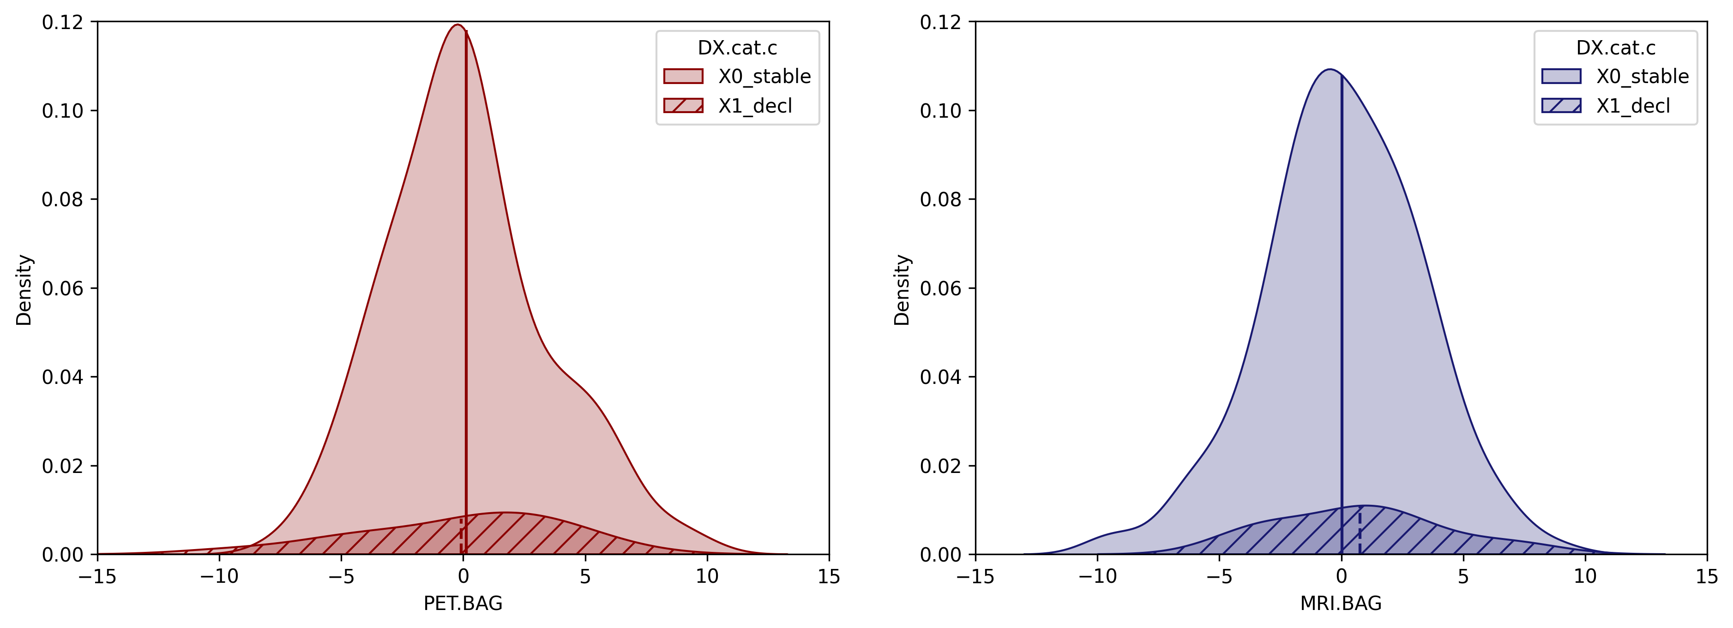

Slide 6
SCD

Slide 7
Correlations
SUMMARYSUVR_WHOLECEREBNORM
FDG-PET BAG
n r CI95% p-val
spearman 82 0.190656 [-0.03, 0.4] 0.094522
MRI BAG:
n r CI95% p-val
spearman 82 0.013653 [-0.21, 0.24] 0.905565
ABETA42_recalculated
FDG-PET BAG
n r CI95% p-val
pearson 77 -0.161349 [-0.38, 0.07] 0.172655
MRI BAG:
n r CI95% p-val
pearson 77 -0.238304 [-0.44, -0.01] 0.042328
TAU
FDG-PET BAG
n r CI95% p-val
spearman 77 -0.155753 [-0.37, 0.08] 0.18823
MRI BAG:
n r CI95% p-val
spearman 77 -0.258662 [-0.46, -0.03] 0.027132
PTAU
FDG-PET BAG
n r CI95% p-val
spearman 77 -0.165186 [-0.38, 0.07] 0.162532
MRI BAG:
n r CI95% p-val
spearman 77 -0.262292 [-0.46, -0.03] 0.024977
PTAU.ABETA42
FDG-PET BAG
n r CI95% p-val
spearman 77 0.087179 [-0.15, 0.31] 0.463316
MRI BAG:
n r CI95% p-val
spearman 77 0.016899 [-0.21, 0.25] 0.887157
ADNI_EF
FDG-PET BAG
n r CI95% p-val
pearson 83 -0.190052 [-0.39, 0.03] 0.093421
MRI BAG:
n r CI95% p-val
pearson 83 0.047778 [-0.18, 0.27] 0.675854
ADNI_MEM
FDG-PET BAG
n r CI95% p-val
pearson 83 -0.25925 [-0.45, -0.04] 0.021048
MRI BAG:
n r CI95% p-val
pearson 83 -0.131784 [-0.34, 0.09] 0.246983

Slide 8
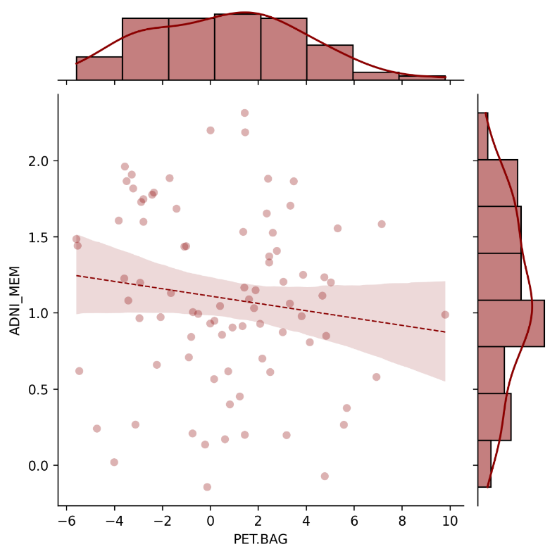
Cognitive Performance
The negative correlation between FDG-PET BAG and memory performance could suggest that FDG-PET BAG is sensitive to very early memory decline that may already be felt by participants. This is also evident from the trend significant advanced FDG-PET BAG (not observed on MRI) in SCD compared to CN as well as, although not significant, the higher BAG in decliners compared to stables.
ADNI-MEM
FDG-PET BAG [years]

Slide 9
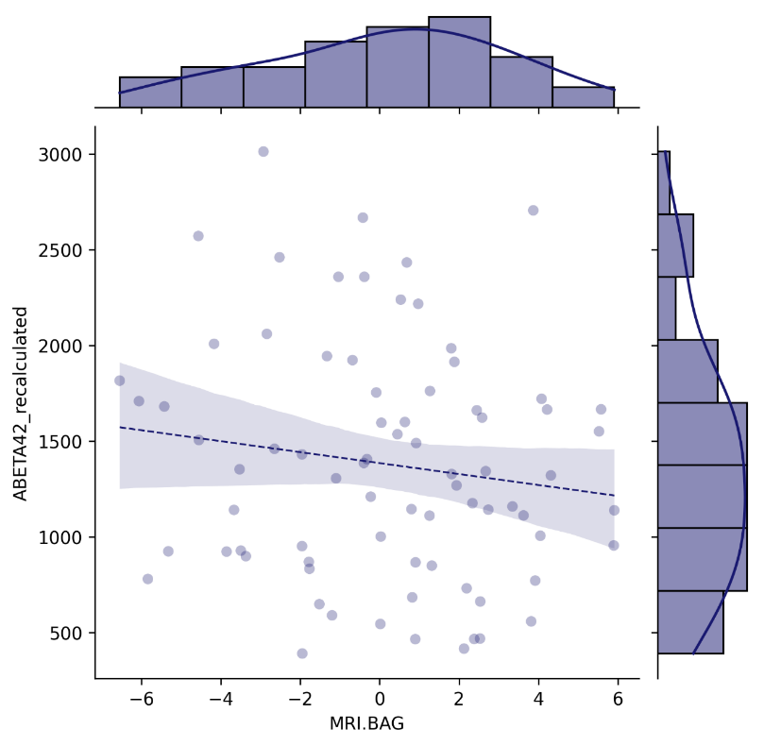
Neuropathology
CSF Aβ₁₋₄₂ [pg/ml]
MRI BAG [years]

Slide 10
Cognitive Decline
FDG-PET BAG:
Source SS DF F p-unc np2
0 DX.cat.n 17.154630 1 1.655094 0.202072 0.020778
1 PTEDUCAT 36.891986 1 3.559371 0.062932 0.043641
2 APOE4 0.483006 1 0.046601 0.829651 0.000597
3 PTGENDER 2.148206 1 0.207261 0.650188 0.002650
Residual 808.450371 78 NaN NaN NaN
MRI BAG:
Source SS DF F p-unc np2
0 DX.cat.n 2.213411 1 0.247204 0.620449 0.003159
1 PTEDUCAT 3.034701 1 0.338930 0.562126 0.004326
2 APOE4 0.929472 1 0.103808 0.748169 0.001329
3 PTGENDER 54.052781 1 6.036876 0.016230 0.071836
Residual 698.393853 78 NaN NaN NaN
Mean FDG-PET BAG stables: [0.44264944], mean FDG-PET BAG decliners: [1.77055891].
Mean MRI BAG stables: [-0.00479381], mean MRI BAG decliners: [0.95311537].

Slide 11
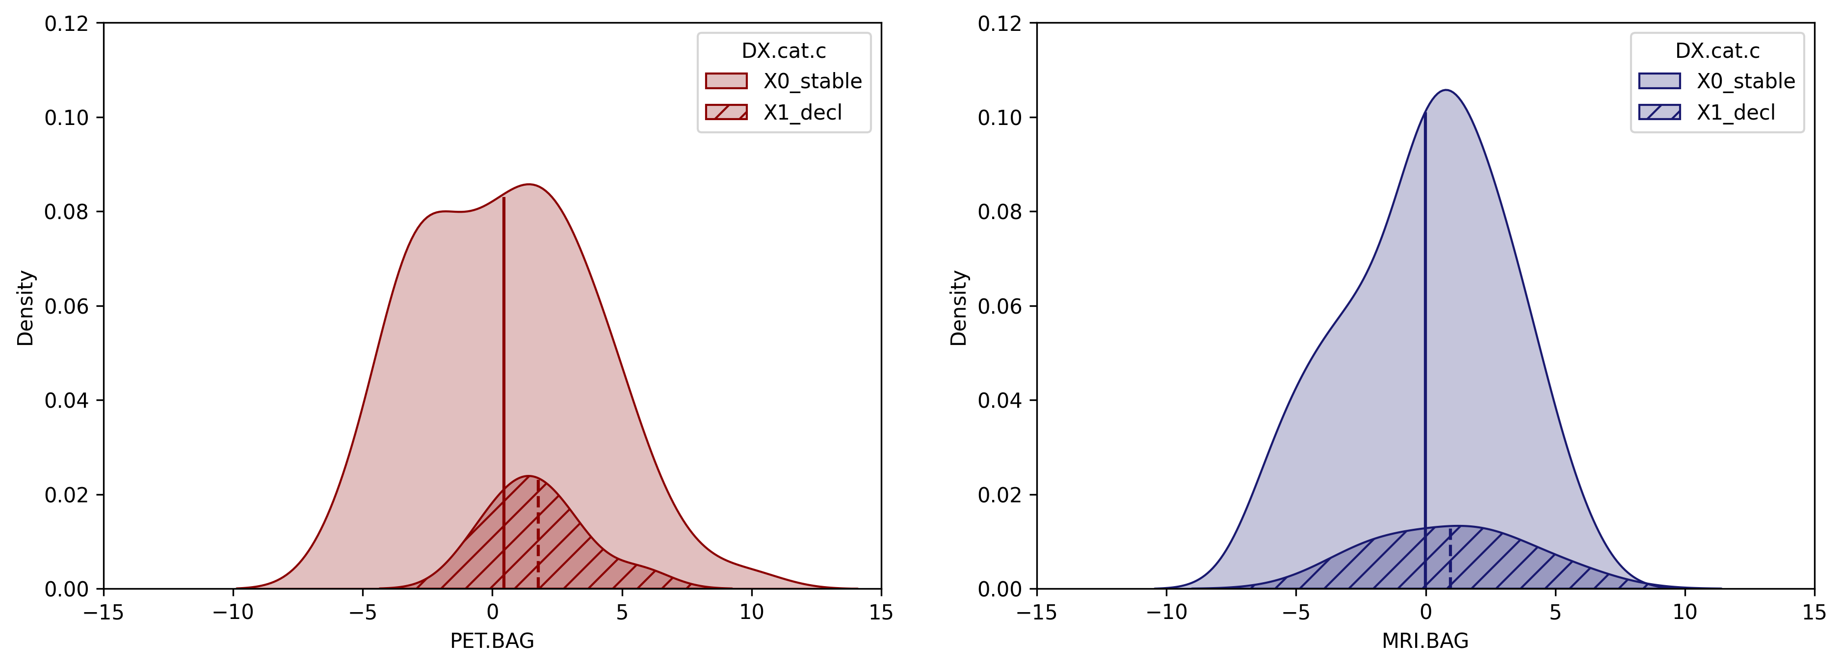
Category
Category
Stable
Decline
Stable
Decline
Density
Density
FDG-PET BAG [years]
MRI BAG [years]

Slide 12
CU

Slide 13
Correlations
SUMMARYSUVR_WHOLECEREBNORM
FDG-PET BAG
n r CI95% p-val
spearman 230 0.061144 [-0.07, 0.19] 0.360211
MRI BAG:
n r CI95% p-val
spearman 230 0.004653 [-0.13, 0.14] 0.944545
ABETA42_recalculated
FDG-PET BAG
n r CI95% p-val
spearman 210 -0.144092 [-0.28, -0.01] 0.038798
MRI BAG:
n r CI95% p-val
spearman 210 -0.075456 [-0.21, 0.06] 0.281061
TAU
FDG-PET BAG
n r CI95% p-val
spearman 210 -0.041969 [-0.18, 0.1] 0.549195
MRI BAG:
n r CI95% p-val
spearman 210 -0.065518 [-0.2, 0.07] 0.349459
PTAU
FDG-PET BAG
n r CI95% p-val
spearman 209 -0.048816 [-0.18, 0.09] 0.487005
MRI BAG:
n r CI95% p-val
spearman 209 -0.055656 [-0.19, 0.08] 0.428001
PTAU.ABETA42
FDG-PET BAG
n r CI95% p-val
spearman 209 0.11616 [-0.02, 0.25] 0.097195
MRI BAG:
n r CI95% p-val
spearman 209 0.019165 [-0.12, 0.16] 0.785052
ADNI_EF
FDG-PET BAG
n r CI95% p-val
pearson 237 -0.019401 [-0.15, 0.11] 0.768312
MRI BAG:
n r CI95% p-val
pearson 237 0.022626 [-0.11, 0.15] 0.731185
ADNI_MEM
FDG-PET BAG
n r CI95% p-val
pearson 237 -0.015334 [-0.14, 0.11] 0.815902
MRI BAG:
n r CI95% p-val
pearson 237 -0.04841 [-0.18, 0.08] 0.462096

Slide 14
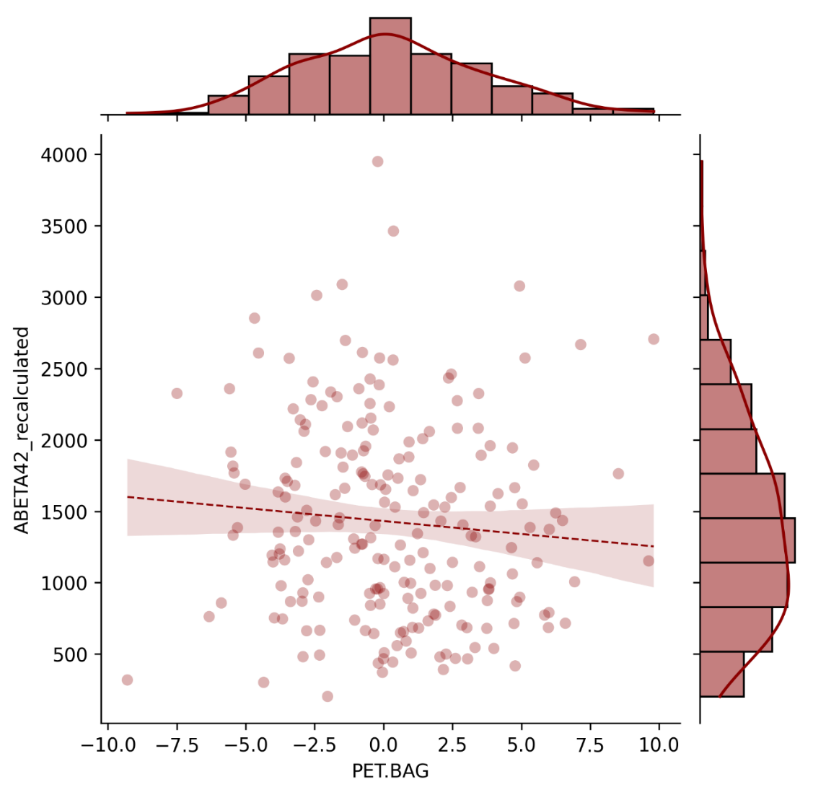
Pathology
CSF Aβ₁₋₄₂ [pg/ml]
FDG-PET BAG [years]

Slide 15
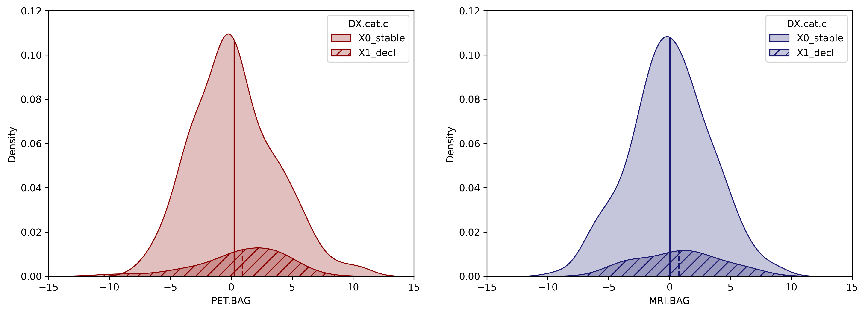
Category
Category
Stable
Decline
Stable
Decline
Density
Density
FDG-PET BAG [years]
MRI BAG [years]

Slide 16
Cognitive Outcome
PET.BAG
237 subjects with full information.
AUC: 0.6305555555555555
MRI.BAG
237 subjects with full information.
AUC: 0.5564935064935066
Hippocampus_GMV
237 subjects with full information.
AUC: 0.7373737373737373
SUMMARYSUVR_WHOLECEREBNORM
230 subjects with full information.
AUC: 0.5454761904761904
Precuneus_SUVR
237 subjects with full information.
AUC: 0.5762626262626263
PTAU.ABETA42
209 subjects with full information.
AUC: 0.6052631578947368
ADNI_MEM
237 subjects with full information.
AUC: 0.7696969696969698
meanage
237 subjects with full information.
AUC: 0.6384199134199134
FDG-PET BAG: Source SS DF F p-unc np2
0 DX.cat.n 6.837289 1 0.619197 0.432149 0.002662
1 PTEDUCAT 23.887457 1 2.163292 0.142697 0.009238
2 APOE4 1.361825 1 0.123329 0.725770 0.000531
3 PTGENDER 16.879719 1 1.528658 0.217564 0.006546
4 Residual 2561.785948 232 NaN NaN NaN
MRI BAG: Source SS DF F p-unc np2
0 DX.cat.n 8.060314 1 0.870007 0.351923 0.003736
1 PTEDUCAT 2.160633 1 0.233212 0.629607 0.001004
2 APOE4 1.332777 1 0.143856 0.704824 0.000620
3 PTGENDER 175.282953 1 18.919538 0.000020 0.075401
4 Residual 2149.399517 232 NaN NaN NaN
Mean PET BAG stables: [0.23242853], mean PET BAG decliners: [0.6248515].
Mean MRI BAG stables: [0.01487119], mean MRI BAG decliners: [0.83653551].

Slide 17
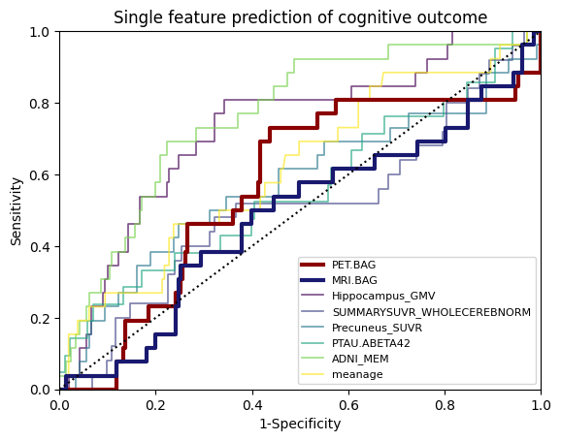
Sensitivity
FDG-PET BAG
MRI BAG
Hippocampus GMV
AV45-PET
Precuneus SUVR
p-tau₁₈₁/Aβ₁₋₄₂ ratio
ADNI-MEM
age
1-Specificity

Slide 18
MCI

Slide 19
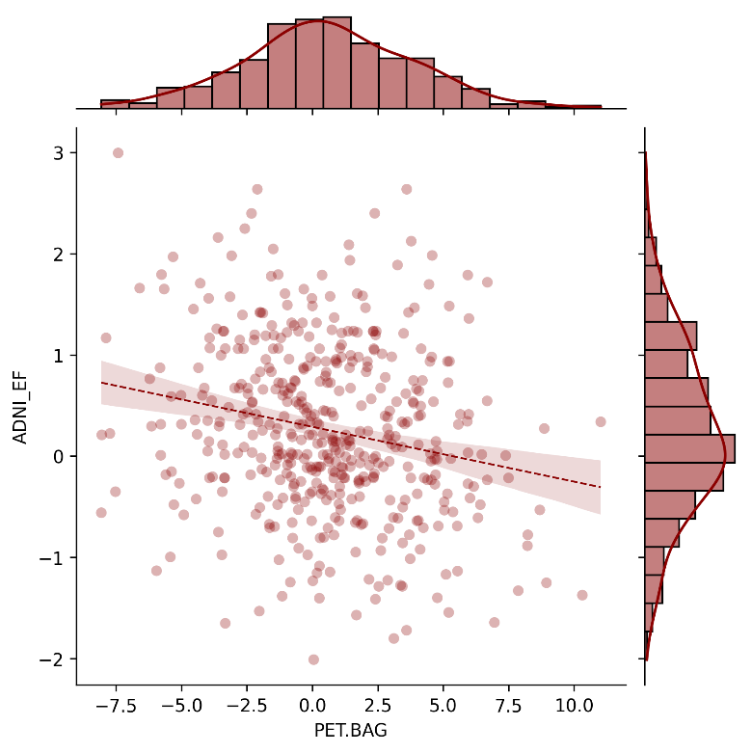
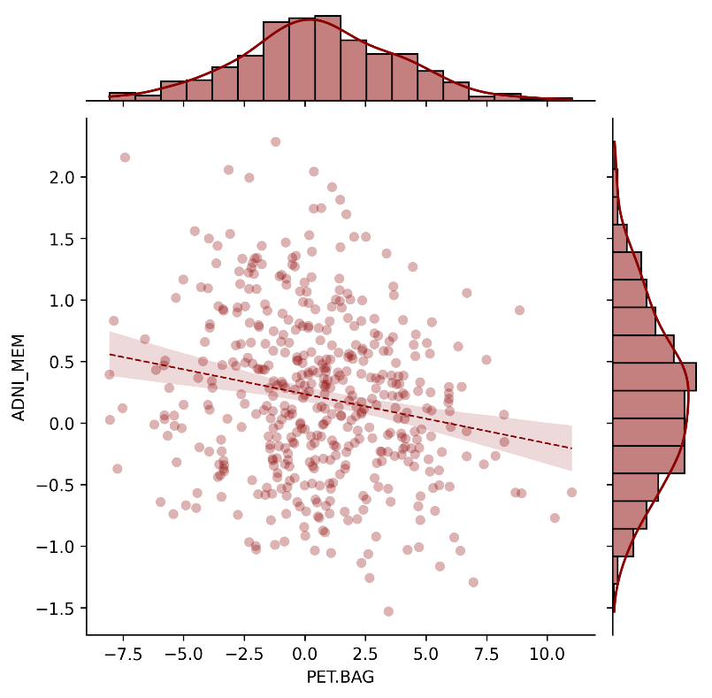
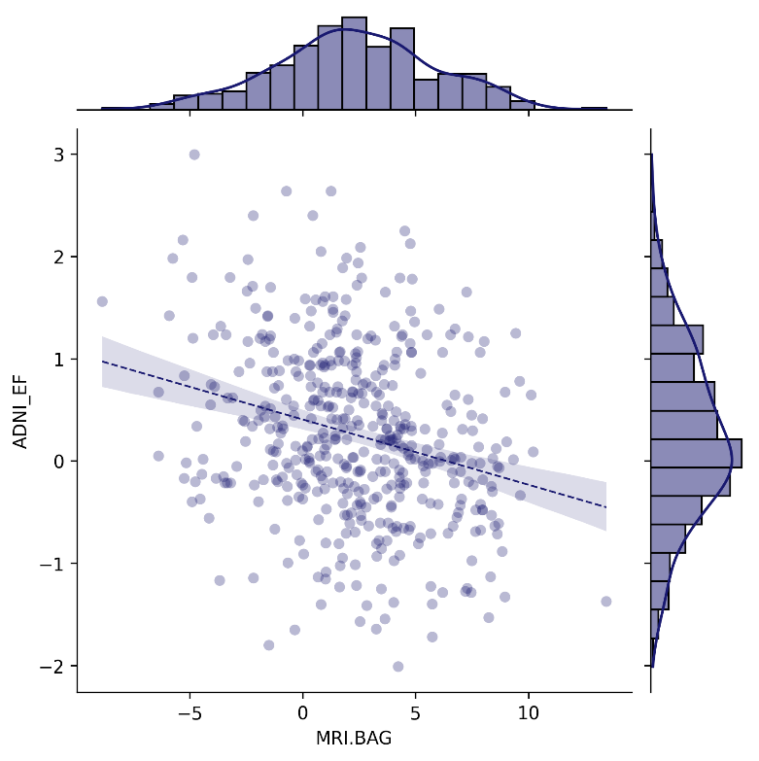
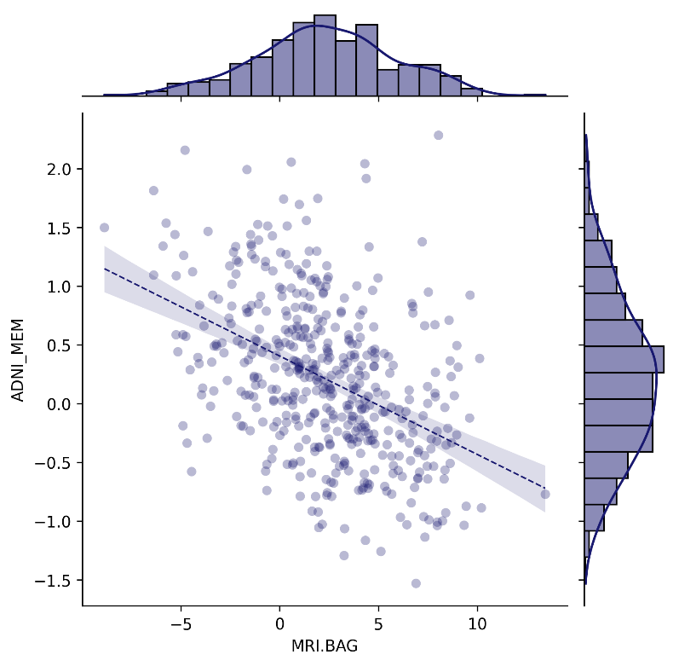
Cognitive Performance
r = -.238, p < .001
r = -.179, p < .001
ADNI-EF
ADNI-MEM
ADNI-MEM
ADNI_EF
FDG-PET BAG
n r CI95% p-val
pearson 460 -0.237727 [-0.32, -0.15] 2.801281e-07
MRI BAG:
n r CI95% p-val
pearson 460 -0.225374 [-0.31, -0.14] 0.000001
ADNI_MEM
FDG-PET BAG
n r CI95% p-val
spearman 460 -0.179125 [-0.27, -0.09] 0.00012
MRI BAG:
n r CI95% p-val
spearman 460 -0.397101 [-0.47, -0.32] 1.126132e-18
FDG-PET BAG [years]
FDG-PET BAG [years]
r = -.225, p < .001
r = -.397, p < .001
ADNI-EF
ADNI-MEM
MRI BAG [years]
MRI BAG [years]

Slide 20
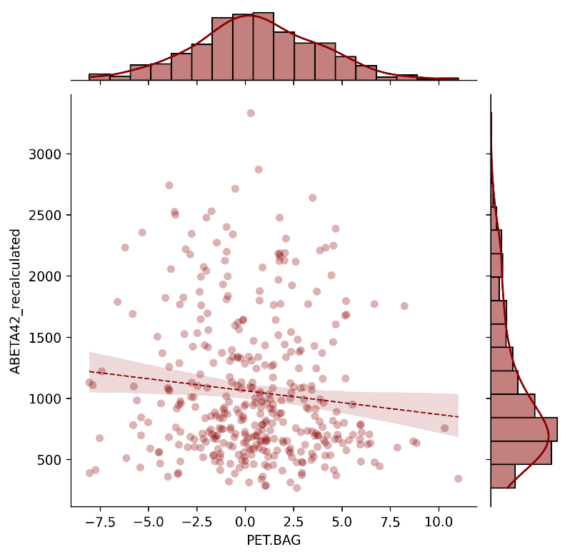
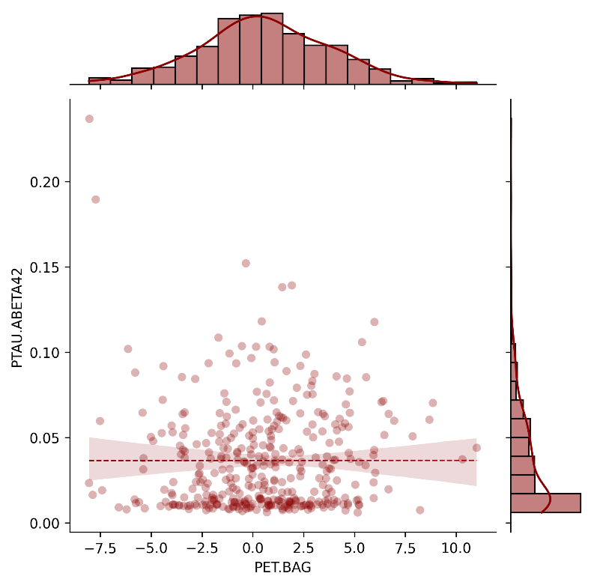
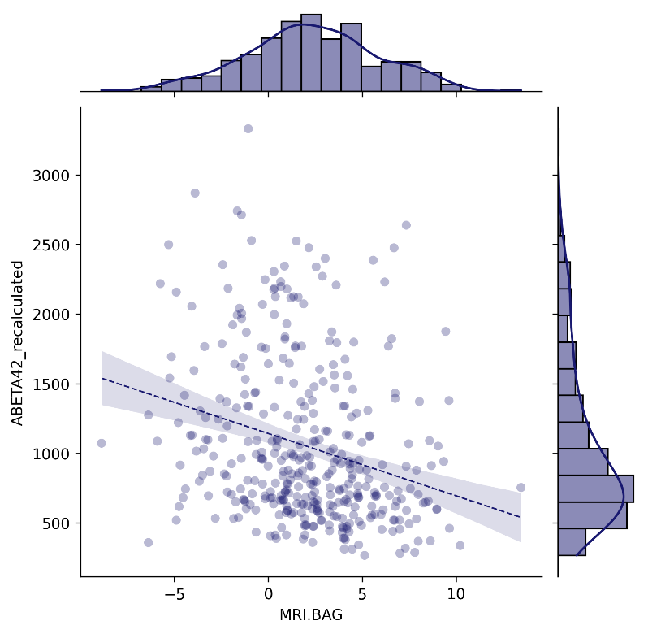
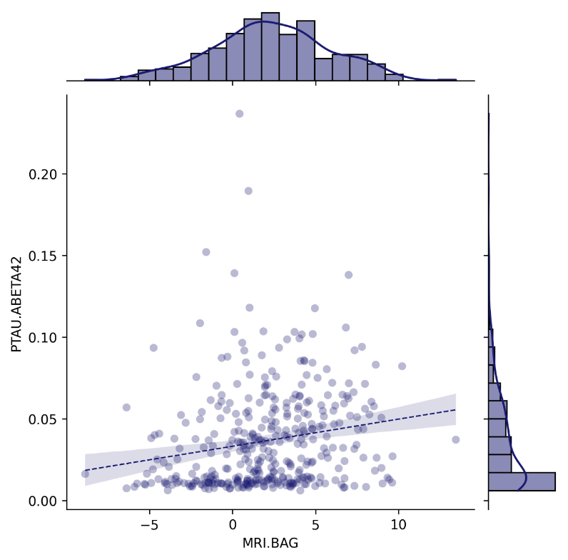
Pathology
rho = -.126, p = .015
rho = .100, p = .052
SUMMARYSUVR_WHOLECEREBNORM
FDG-PET BAG
n r CI95% p-val
spearman 326 0.056035 [-0.05, 0.16] 0.316159
MRI BAG:
n r CI95% p-val
spearman 326 0.095495 [-0.01, 0.2] 0.08711
ABETA42_recalculated
FDG-PET BAG
n r CI95% p-val
spearman 376 -0.12584 [-0.22, -0.02] 0.015157
MRI BAG:
n r CI95% p-val
spearman 376 -0.230316 [-0.32, -0.13] 0.000007
TAU
FDG-PET BAG
n r CI95% p-val
spearman 376 0.00831 [-0.09, 0.11] 0.87309
MRI BAG:
n r CI95% p-val
spearman 376 0.047291 [-0.05, 0.15] 0.363057
PTAU
FDG-PET BAG
n r CI95% p-val
spearman 376 0.009136 [-0.09, 0.11] 0.860591
MRI BAG:
n r CI95% p-val
spearman 376 0.055329 [-0.05, 0.16] 0.287158
PTAU.ABETA42
FDG-PET BAG
n r CI95% p-val
spearman 376 0.100708 [-0.0, 0.2] 0.052285
MRI BAG:
n r CI95% p-val
spearman 376 0.200282 [0.1, 0.3] 0.000101
CSF Aβ₁₋₄₂ [pg/ml]
p-Tau₁₈₁/CSF Aβ₁₋₄₂ ratio
FDG-PET BAG [years]
FDG-PET BAG [years]
rho = -.230, p < .001
rho = .200, p < .001
CSF Aβ₁₋₄₂ [pg/ml]
p-Tau₁₈₁/CSF Aβ₁₋₄₂ ratio
MRI BAG [years]
MRI BAG [years]

Slide 21
FDG-PET BAG:
Source SS DF F p-unc np2
0 DX.cat.n 95.843181 1 9.346308 0.002366 0.020128
1 PTEDUCAT 1.202126 1 0.117227 0.732219 0.000258
2 APOE4 4.202522 1 0.409816 0.522385 0.000900
3 PTGENDER 39.643049 1 3.865858 0.049886 0.008425
4 Residual 4665.868761 455 NaN NaN NaN
MRI BAG:
Source SS DF F p-unc np2
0 DX.cat.n 657.402966 1 66.034264 4.221225e-15 0.126737
1 PTEDUCAT 0.499288 1 0.050152 8.228994e-01 0.000110
2 APOE4 0.486270 1 0.048844 8.251856e-01 0.000107
3 PTGENDER 347.291806 1 34.884477 6.856291e-09 0.071210
4 Residual 4529.744589 455 NaN NaN NaN
Mean FDG-PET BAG stables: [0.30563297], mean FDG-PET BAG decliners: [1.3491923].
Mean MRI BAG stables: [1.58252294], mean MRI BAG decliners: [4.50295814].

Slide 22
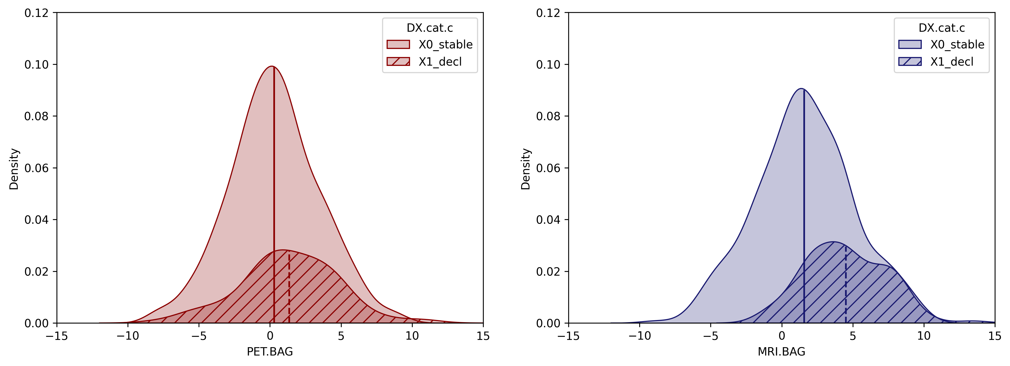
p = .002
Category
p < .001
Category
Stable
Decline
Stable
Decline
Density
Density
FDG-PET BAG [years]
MRI BAG [years]
Notes:
R ANCOVA results pending

Slide 23
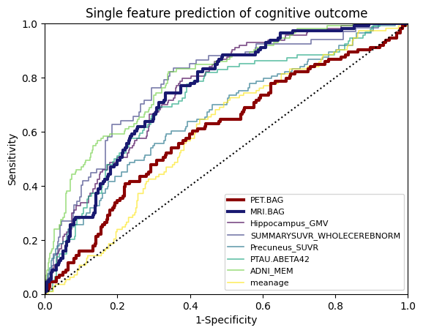
PET.BAG
460 subjects with full information.
AUC: 0.6058651642475171
MRI.BAG
460 subjects with full information.
AUC: 0.7504469060351414
Hippocampus_GMV
460 subjects with full information.
AUC: 0.7588286223580342
SUMMARYSUVR_WHOLECEREBNORM
326 subjects with full information.
AUC: 0.7859267399267399
Precuneus_SUVR
460 subjects with full information.
AUC: 0.6707620320855614
PTAU.ABETA42
376 subjects with full information.
AUC: 0.7263095238095237
ADNI_MEM
460 subjects with full information.
AUC: 0.7968270944741532
meanage
460 subjects with full information.
AUC: 0.6065234275528393
Sensitivity
FDG-PET BAG
MRI BAG
Hippocampus GMV
AV45-PET
Precuneus SUVR
p-tau₁₈₁/Aβ₁₋₄₂ ratio
ADNI-MEM
age
1-Specificity

Slide 24
THRESHOLD FOR DELCODE

